Slide 1
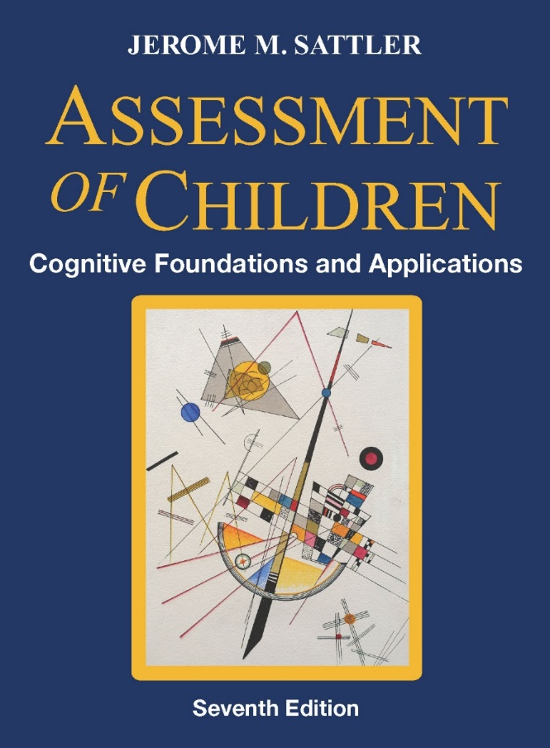
PowerPoint Presentation for the Psychologists' Association of Alberta
Assessment of Children: Cognitive Foundations and Applications, Seventh Edition
© 2024 by Jerome M. Sattler, Publisher, Inc.

Slide 2
Overview [1]
Inside front cover
Inside back cover
Organization of text
Main text: 20 chapters
3 new chapters:
Learning Disability (Chapter 17)
Intellectual Disability (Chapter 18)
Giftedness and Creativity (Chapter 19)

Slide 3
Overview [2]
Organization of text (Cont.)
Resource Guide: 15 appendixes
Appendixes A through G cover specialized information about the major IQ tests
Note that Table A-15 in Appendix A provides an administrative checklist for the WISC-V Q-interactive

Slide 4
Overview [3]
Organization of text (Cont.)
Resource Guide: 15 appendixes
Each test has one or more tables covering interpretive rationales, implications of high and low scores, and instructional implications for the subtests and, in some cases, the index scores and full scale IQ.
Appendix H covers more specialized IQ tests

Slide 5
Overview [4]
Organization of text (Cont.)
Resource Guide: 15 appendixes
Appendix I covers academic achievement tests
Appendix J covers expressive and receptive language tests
Appendix K covers ethical, legal, and professional issues (A shorter version of this appendix was in Chapter 3 in the Sixth Edition)

Slide 6
Overview [5]
Organization of text (Cont.)
Resource Guide: 15 appendixes
Appendix L covers statistics and psychometrics (This material was covered in Chapter 4 in the Sixth Edition)

Slide 7
Overview [6]
Organization of text (Cont.)
Resource Guide: 15 appendixes
Appendix M covers miscellaneous tables and exhibits
Appendix N covers US Laws covering disability evaluation
Appendix O covers challenges of being an expert witness

Slide 8
Overview [7]
Errata sheet: https://sattlerpublisher.com/cog7e_errata.htm
In the main text:
1. Table 7-20 in Chapter 7, p. 267 is incorrect. Go to the errata sheet shown above to see the corrected Table 7-20.
2. Chapter 16, p. 626, right column, last bullet should read:
Table D.4 shows the percentile ranks corresponding to standard scores and scaled scores. Tables BC-1 and BC-8 on the inside back cover provide similar information.

Slide 9
Overview [8]
Errata sheet: https://sattlerpublisher.com/cog7e_errata.htm
(Cont.)
In the Resource Guide:
1. Missing Table M-4. “Teacher and Parent Recommendation Form for Children Who Are Gifted and Talented”
2. Missing Table M-5. “Parent and Teacher Recommendation Form for Preschool Children Who Are Gifted and Talented”
3. Missing Table M-6. “Checklist for Identifying Children Who Are Creative”

Slide 10
Overview [9]
Questions from School Psychologists in Alberta
What can we do about the "checklist" psychology that has been pervading the discipline, including the checklists that are being published as part of the DSM? These are not normed, are minimally standardized, and seem to be psychiatry's response to the need for "psychological assessment." Many practitioners seem to be turning to checklists and foregoing multi-source, multi-method assessment for intake, diagnosis, formulation of treatment plans, and outcome evaluation.

Slide 11
Overview [10]
Questions from School Psychologists in Alberta (Cont.)
What nonverbal intelligence test provides a reliable or satisfactory "FSIQ" score to diagnose an intellectual disability in individuals with limited speech?
On the WISC-V, the Visual Spatial, Fluid Reasoning, and Processing Speed do not require verbal responses and provide estimates of intellectual ability.

Slide 12
Overview [11]
Questions from School Psychologists in Alberta (Cont.)
Many of the tests covered in App. H (e.g., C-TONI 2, Leiter-3, Raven’s Progressive Matrices are useful for providing an estimate of intellectual ability.

Slide 13
Canadian WISC-V [1]
Babcock et al. (2018)
Babcock et al. (2018) recommend that Canadian WISC–V norms be used in the assessment of children with special needs who reside in Canada.
The Canadian norms are more sensitive than U.S. norms in identifying intellectual differences among Canadian children.

Slide 14
Canadian WISC-V [2]
Babcock (2017)
Table 7-19 (p. 267) shows the WISC–V FSIQs for four ethnic groups living in Canada.
Children who are Asian obtained the highest mean IQ, followed by children who are European, Other, and First Nations.

Slide 15
Canadian WISC-V [3]
Babcock (2017) (Cont.)
Table 7-20 (see errata sheet) shows the relationship between Canadian parent education level and WISC–V FSIQ.
Children with the highest FSIQs had parents who had an undergraduate degree or more, while children with the lowest FSIQs had parents who had no high school or some high school but did not have a high school diploma.

Slide 16
Canadian WISC-V [4]
Watkins et al. (2018)
A factor analysis of the 16 subtests in the WISC–V Canadian standardization group indicated that four group factors and one general factor best accounted for the structure of the test.

Slide 17
Canadian WISC-V [5]
Cormier et al. (2016)
Cormier et al. (2016) studied the linguistic demands in the oral directions for three Canadian WISC–V subtests—Picture Span, Visual Puzzles, and Figure Weights—by examining the average number of words and syllables per word in each sentence in the directions.
The oral directions for these three WISC–V subtests were found to make relatively high linguistic demands.

Slide 18
Canadian WISC-V [6]
O’Brien et al. (2022)
O’Brien et al. (2022) studied the paper-and-pencil and digital versions of the WISC-V Coding subtest.
N = 212 (total) Canadian school-aged children between 6 and 14 years old
N = 116 completed the paper version
N = 96 completed the digital version

Slide 19
Canadian WISC-V [7]
O’Brien et al. (2022) (Cont.)
Results showed that higher scores were obtained on the digital version (M = 12.81) than on the paper version (M = 9.50), a difference of 3.31.
Pearson recommends that the evaluator provide the client with the paper response booklet and then transfer the scoring information onto the Q-interactive platform

Slide 20
Canadian WISC-V [8]
O’Brien et al. (2022) (Cont.)
Additional studies are needed that compare the digital and paper versions of all psychological tests.

Slide 21
Canadian WISC-V [9]
O'Brien, A. M., Bartlett, A. N., Frost, N., & Casey, J. E. (2022). Inflated scaled scores on the digital WISC-V coding subtest in a Canadian sample. Applied Neuropsychology: Child, 11(2), 150–157. https://doi.org/10.1080/21622965.2020.1773270

Slide 22
Statistics About SLD in Canada [1] (pp. 686–687)
The percentage of Canadian school-aged children (ages 5 to 17) that have a learning disability/disorder is 8.4% (10.6% male/6.1% female), or 422,300.
Source: Canadian Health Survey on Children and Youth. (2019). Health characteristics of children and youth aged 1 to 17 years, Canadian Health Survey on Children and Youth 2019.

Slide 23
Reading Disorder in Canada (pp. 692-695)
Reading disorder is the most common type of SLD
Approximately 80% of children with learning disabilities in Canada have reading-related difficulties (ChatGPT, April 10, 2024). [This is the same percentage found in the US.]

Slide 24
Does Scatter Invalidate the Full Scale IQ (FSIQ)? [1](pp. 367-369)
YES
Kaufman & Lichtenberger (1999) advised that WAIS-III FSIQ may be meaningless and uninterpretable if there is a large difference between the Verbal and Performance IQs or if there is too much scatter among the subtests
Same advice was given for the WISC-III and WPPSI-R by Kaufman & Lichtenberger (2000)
Notes:
24

Slide 25
Does Scatter Invalidate the Full Scale IQ (FSIQ)? [2](pp. 367-369)
YES (Cont.)
Global IQs are rendered uniterpretable by significant variability among their parts—Flanagan & Kaufman (2004)
When the Index scores are variable, the FSIQ is less valid—Fiorello et al. (2007)
The construct validity of FSIQ is diminished when variability is present—Hale et al. (2007)
Notes:
25

Slide 26
Does Scatter Invalidate the Full Scale IQ (FSIQ)? [3] (pp. 367-369)
YES (Cont.)
The FSIQ becomes contaminated with a high degree of differences among index scores—Groth-Marnat (2009)
See other sources on pp 367-368.
Notes:
26

Slide 27
Does Scatter Invalidate the Full Scale IQ (FSIQ)? [4] (pp. 367-369)
NO
The FSIQ is a robust predictor of achievement for both regular and clinical samples, regardless of factor variability—Watkins, Glutting, & Lei (2007; see p. 368 in text)
The FSIQ is equally valid at all levels of scatter—Daniel (2007)
Notes:
27

Slide 28
Does Scatter Invalidate the Full Scale IQ (FSIQ)? [5] (pp. 367-369)
NO (Cont.)
In KABC-II, the general factor and broad abilities can be interpreted even when there is scatter—McGill (2016)
The FSIQ is a valid predictor of academic achievement even in the presence of significant scatter—Freberg et al. (2008)
Notes:
28

Slide 29
ICD-11[1]
ICD-11 was released by the World Health Organization (WHO) in June 2018.
Smaller updates and revisions often occur to address emerging health issues, new diseases, or changes in medical terminology.
ICD-11 is fully electronic and provides access to 17,000 diagnostic categories, with over 100,000 medical diagnostic index terms.

Slide 30
ICD-11[2]
TABLE 6.1: Behavioural Indicators Of Intellectual Functioning [see Table 18-2 on pp. 728-729 for a brief overview of the table]
Link: https://icd.who.int/browse/2024-01/mms/en#605267007

Slide 31
ICD-11[2]
Link: https://icd.who.int/browse/2024-01/mms/en
Source: ChatGPT and Google

Slide 32
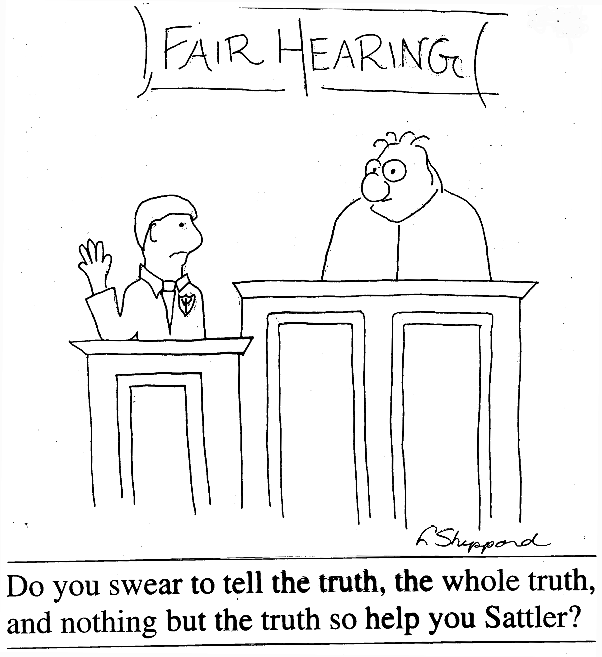

Slide 33
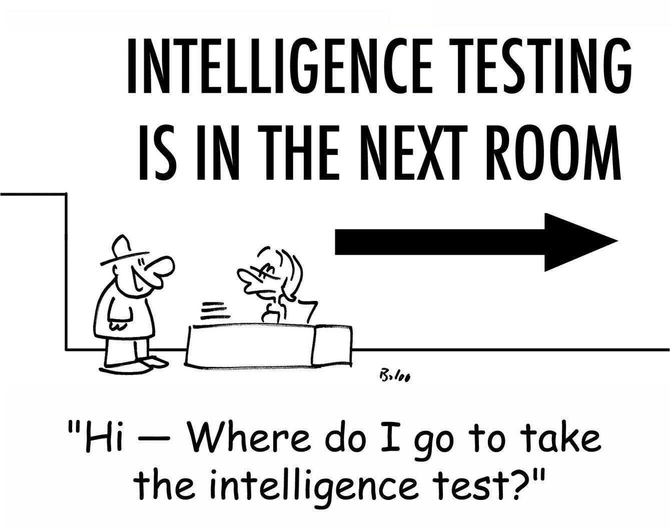

Slide 34
Chapter 1
Challenges in Assessing Children: The Process

Slide 35
Chapter 1 [1]
Informal assessments: Table 1-1 (p. 10)
Multimethod assessment
Figure 1-3 (p. 11)
Exhibit 1-3 (p. 13)

Slide 36
Chapter 1 [2]
Reviewing assessment measures: Exhibit 1-4 (p. 17)
Decision-making model: Figure 1-5 (p. 21)

Slide 37
Chapter 1 [3]
Concluding Comment for Chapter 1
Lovett and Nelson (2020, p. 494) provided the following overview of the assessment process:
“The regulations governing school-based evaluations are sometimes very different from what clinicians in private practice operate under.

Slide 38
Chapter 1 [4]
Concluding Comment (Cont.)
Different methods of assessing learning problems each have their own advantages and disadvantages.
Determining a student’s need for testing accommodations can be a complex, multifaceted process; and formally monitoring student motivation and effort during an evaluation is paramount but often neglected.

Slide 39
Chapter 1 [5]
Concluding Comment (Cont.)
These challenges can be off-putting but they are also what makes the work so exciting.

Slide 40
Chapter 1 [6]
Concluding Comment (Cont.)
Given the importance of valid assessment practices in this context, we hope that clinicians are motivated to surmount these challenges and perform evaluations that yield accurate information about children and adolescents, leading to thoughtful and evidence-based decisions about diagnoses, accommodations, and interventions for struggling youth.”

Slide 41
Chapter 2
Challenges in Assessing Children: The Context See pp. 25-66

Slide 42
Chapter 3
Culturally and Linguistically Diverse Children See pp. 67-111

Slide 43
Chapter 4
Role of the Evaluator in the Assessment Process

Slide 44
Chapter 4 [1]
Checklist for General Test Administration Practices:
Table 4-2 (p. 120)
Questions to consider about a child during an assessment:
Exhibit 4-1 (pp. 127-130)
Observing verbal behavior:
Exhibit 4-1 (pp. 127-130)
Exhibit 4-2 (pp. 133-134)

Slide 45
Chapter 4 [2]
Behavior and attitude checklist: Table 4-4 (p. 137)

Slide 46
Chapter 5
Historical Survey and Theories of Intelligence

Slide 47
Chapter 5 [1]
“Intelligence is important in psychology for two reasons. First, it is one of the most scientifically developed corners of the subject, giving the student as complete a view as is possible anywhere of the way scientific method can be applied to psychological problems. Secondly, it is of immense practical importance, educationally, socially, and in regard to physiology and genetics.”
— Raymond Cattell

Slide 48
Chapter 5 [2]
“Our purpose is to be able to measure the intellectual capacity of a child who is brought to us in order to know whether he is normal or retarded. ... We do not attempt to establish or prepare a prognosis and we leave unanswered the question of whether this retardation is curable, or even improveable. We shall limit ourselves to ascertaining the truth in regard to his present mental state.”
— Alfred Binet

Slide 49
Chapter 6
Correlates of Intelligence

Slide 50
Executive Functions [1] (pp. 203-205)
Primary executive functions (see p. 203)
Executive functions, genetics, and intelligence (see p. 204)
Assessment of executive functions (see p. 204 and Table 6-3 on p. 205)

Slide 51
Life Outcomes and Intelligence [1] (pp. 204-207)
Research shows a strong relationship between intelligence test scores and life outcomes such as economic and social competence. For example:
Achieved better educational goals
Achieved better job attainment
Reduced risk of mental health problems
Better mortality

Slide 52
Life Outcomes and Intelligence [2] (pp. 204-207)
Fewer hospitalizations
Higher annual income

Slide 53
Stability and Change in Intelligence [1] (pp. 207-208)
The studies on stability and change in intelligence are on pp. 207-208.
The older the child is when first tested and the shorter the interval between tests, the greater the constancy of the IQ.

Slide 54
Stability and Change in Intelligence [2] (pp. 207-208)
Despite high test‑retest correlations, it is important to conduct frequent and periodic testing if test scores are used for guidance or placement decisions.
Thus, extreme caution must be used in predicting a child’s future level of intellectual functioning.

Slide 55

“The Board of Education authorized seeing eye dogs and canes for all students who have smartphones.”

Slide 56
Chapter 7
Wechsler Intelligence Scale for Children– Fifth Edition (WISC–V): Description

Slide 57
History of the WISC–V (not in text)
WISC 1st published in 1949
WISC–R first revision published in 1974
WISC–III next revision published in 1991
WISC–IV next revision published in 2003
WISC–V latest revision published in 2014
Revisions of the WISC
David Wechsler, the original author, died in 1982.

Slide 58
Supplementary Instructions for Administration [1] (pp. 252–253)
Exhibit 7-2
Study carefully the supplementary instructions for administering the WISC–V
The instructions cover the following areas:
Preparing to administer the WISC–V
Administering the WISC–V
Scoring
Record Form
Notes:
58

Slide 59
Supplementary Instructions for Administration [2] (pp. 252–253)
Exhibit 7-2 (Cont.)
The instructions cover the following areas:
General guidelines for completing the Record Form
Miscellaneous information and suggestions
Notes:
59

Slide 60
Subtest Substitution in the WISC–V [1] (p. 259)
Only substitute a subtest if absolutely necessary
When you substitute,
Psychometric properties of the FSIQ may change
Reliabilities and validities of the FSIQ may change
Confidence intervals of the FSIQ may change
Notes:
60

Slide 61
Subtest Substitution in the WISC–V [2] (p. 259)
When you substitute, (Cont.)
No empirical data for substitutions
No empirical data for number of substitutions
Notes:
61

Slide 62
Potential Problems in Administering the WISC–V (pp. 260–263)
See potential problems (see Exhibit 7-3, pp. 261–262)

Slide 63
Strengths of WISC–V (p. 267)
Excellent standardization
Good overall psychometric properties
Useful diagnostic information
Good administration procedures
Good manuals and interesting test materials
Helpful scoring criteria
Usefulness for children with some disabilities

Slide 64
Limitations of WISC–V [1] (pp. 268–269)
Limited breadth of coverage of the FSIQ
Failure to provide conversion tables when substitutions are made
Failure to provide a psychometric basis for requiring raw scores of 1 in order to compute FSIQ
Limited range of scores for extremely low or high functioning children

Slide 65
Limitations of WISC–V [2] (pp. 268–269)
Limited criterion validity studies
Possible difficulties in scoring responses
Somewhat large practice effects
Occasional confusing guidelines
Poor quality of some test materials

Slide 66
Chapter 8
WISC–V Subtests see pp. 275-337

Slide 67
Chapter 9
Interpreting the WISC–V

Slide 68
Cognitive Proficiency Index (p. 342)
Digit Span
Picture Span
Coding
Symbol Search
[A measure of working memory and processing speed; Similarities, Vocabulary, Block Design, Matrix Reasoning, and Figure Weights are NOT part of the CPI]
Notes:
68

Slide 69
General Ability Index (p. 342)
Similarities
Vocabulary
Block Design
Matrix Reasoning
Figure Weights
[A measure of verbal comprehension and perceptual reasoning; Digit Span, Picture Span, Coding, and Symbol Search are NOT part of the GAI]
Notes:
69

Slide 70
Is the Cognitive Proficiency Index a Misnomer? [1] (p. 369)
Definition of Cognitive
“of or relating to the mental processes of perception, memory, judgment, and reasoning, as contrasted with emotional and volitional processes.”
From: dictionary.com
Notes:
70

Slide 71
Is the Cognitive Proficiency Index a Misnomer? [2] (p. 369)
Definition of Proficiency
“a high degree of competence or skill; expertise”
From: google.com
Notes:
71

Slide 72
Is the General Ability Index a Misnomer? [3] (p. 369)
Definition of General Ability
“a term that is used to describe the measurable ability believed to underlie skill in handling all types of intellectual tasks.”
“Our general ability is the skill underlying all tasks.”
From: psychologydictionary.org
Notes:
72

Slide 73
A Successive Level of Approach to Test Interpretation (p. 370)
Level 1: Full Scale, Total Scale, General Intellectual Ability
Level 2: Index, composite, or cluster standard scores
Level 3: Scaled scores
Level 4: Intersubtest variability
Level 5: Intrasubtest variability
Level 6: Qualitative analysis

Slide 74
Reflections on Intelligence and Childhood
“Too often we give children answers to remember rather than problems to solve.”
—Roger Lewin

Slide 75
Chapters 10, 11, & 12
CHAPTER 10
Description of WPPSI-IV: pp. 377-422
CHAPTER 11
WPPSI-IV subtests: pp. 423-464
CHAPTER 12
Interpreting the WPPSI-IV: pp. 465-492

Slide 76
Substitution and Proration on the WPPSI–IV [1] (p. 412)
Zhu and Cayton (2013) report that substitution or proration can lead to increased measurement error and to changes of as much as 15 points (higher or lower) in the FSIQ.
More studies are needed on substitution and proration for all tests.

Slide 77
Chapters 13, 14, 15, & 16
CHAPTER 13
SB5: pp. 493-532
CHAPTER 14
DAS-II NU: pp. 533-580
CHAPTER 15
WJ IV COG: pp. 581-618
CHAPTER 16
KABC-II NU: pp. 619-680

Slide 78
Chapter 17
Specific Learning Disability

Slide 79
Definitions of SLD [1] (pp. 682–685)
Definition from Learning Disabilities Association of Canada: See p. 683
First, it emphasizes that disorders can be in either verbal or nonverbal areas.
Second, it indicates that a learning disability label applies only to individuals who have average thinking and/or reasoning abilities.

Slide 80
Definitions of SLD [2] (pp. 682–685)
Definition from Learning Disabilities Association of Canada: See p. 683 (Cont.)
Third, it emphasizes that learning disability also may involve problems in organizational skills, social perception, social interaction, and perspective taking.
Finally, it stresses the need for early identification and intervention.

Slide 81
Definitions of SLD [3] (pp. 682–685)
The phrase “unexpected academic under-achievement” in the preceding definition of learning disability, although not explained, presumably refers to academic achievement that is lower than would be expected from the child’s intelligence.

Slide 82
Definitions of SLD [4] (pp. 682–685)
However, if a child had poor phonological awareness, a weakness in rapid automatized naming, and a history of delayed oral language development, we would “expect” difficulties with reading and writing regardless of the child’s intelligence.

Slide 83
Key Aspects of Student Learning [1] (pp. 682–685)
Exhibit 17-1 (p. 685) presents 20 principles that identify key aspects of student learning and intellectual and socioemotional development that are likely to facilitate successful classroom teaching and learning

Slide 84
Etiology of SLD (pp. 687–688)
Genetic: See pp. 687-688
Biological: See p. 688
Environmental: See p. 688
See Figure 17-2 on p. 688

Slide 85
Precursors of SLD Among Children of Preschool Age (p. 689)
Delays or deficits in one or more of the following areas:
Motor development
Behavioral development
Cognitive/executive development
Memory
Communication
Perceptual development
Social-emotional development

Slide 86
SLD Among School-Age Children [1] (pp. 689-692)
School-age children with SLD may have cognitive and academic deficits, information-processing and executive function deficits, perceptual deficits, and social-behavioral deficits
See Table 17-1 (p. 690) for deficits associated with SLD
Co-occurring disorders: See pp. 689-690

Slide 87
SLD and Intellectual Disability (p. 692)
Specific learning disabilities and intellectual disabilities: See p. 692
Children with SLD may have narrowly focused limitations, whereas children with intellectual disability may have a pervasive deficiency.
Children with SLD usually can learn appropriate compensatory strategies (e.g., how to study) more quickly than can children with intellectual disability.

Slide 88
SLD and ELL (p. 692)
Specific learning disabilities and English Language Learners (ELL): See p. 692
See six factors (p. 692) need to be considered when the child being assessed for a possible SLD is an ELL

Slide 89
Reading Disorder [1] (pp. 692-695)
Children are not usually considered to have a reading disorder if they
have below-average intelligence (unless their reading ability is well below the level expected for their level of intelligence)
have had poor educational experiences
have not attended school
have not had the opportunity to acquire English language skills

Slide 90
Reading Disorder [2] (pp. 692-695)
Reading disorder difficulties (also see Figure 17-4):
Attention and concentration
Orthographic awareness difficulties
Phonological awareness difficulties
Pragmatic awareness difficulties
Rapid decoding difficulties
Rapid naming difficulties
Semantic difficulties
Verbal comprehension difficulties
Word awareness difficulties

Slide 91
Reading Disorder [3] (pp. 692-695)
Subtypes of reading disorder (see Figure 17-5)
Phonological dyslexia
Fluency/naming speed deficit
Comprehension deficit

Slide 92
Reading Disorder [4] (pp. 692-695)
Five executive functions play a role in the activation and suppression of information during reading and help with reading comprehension:
Flexibility
Inhibition
Shifting
Updating
Working memory

Slide 93
Reading Disorder [5] (pp. 692-695)
Neurological correlates of reading disorder: See pp. 694-695

Slide 94
Mathematics Disorder (p. 695)
See p. 695

Slide 95
Disorders of Written Expression [1](pp. 695-696)
See pp. 695-696

Slide 96
Communication Disorders (pp. 696-697)
See pp. 696-697

Slide 97
Nonverbal Learning Disability (pp. 697-698)
See pp. 697-698

Slide 98
Assessment of SLD [1] (pp. 698-703)
See pp. 698-703
See Table 17-2 for Examples of Tests Used to Assess SLD

Slide 99
Assessment of SLD [1] (pp. 698-703)
Appropriate assessment procedures:
See Appendix I in the Resource Guide (pp. 313-338) for measures of academic achievement
See Appendix J in the Resource Guide (pp. 339-366) for measures of receptive and expressive language

Slide 100
Assessment of SLD [2] (pp. 698-703)
Assessment of reading skills:
See pp. 699, 702

Slide 101
Assessment of SLD [3] (pp. 698-703)
Assessment of written expression (includes spelling):
See p. 702

Slide 102
Assessment of SLD [4] (pp. 698-703)
Assessment of mathematics ability:
See p. 702
Assessment of social and environmental influences:
See p. 702

Slide 103
Assessment of SLD [5] (pp. 698-703)
Assessment of personality, temperament, and attitudes toward school:
See p. 703

Slide 104
Assessment of SLD [6] (pp. 698-703)
Curriculum-Based Measures (CBM):
See p. 703
Also see Table 17-2 for tests that have “b” superscript (the “b” superscript refers to a curriculum-based measure)

Slide 105
General Approach to Identifying SLD [1] (pp. 703-708)
Response to Intervention Models (RTI)
See pp. 703-705
Discrepancy Models: see pp. 705-706
Patterns of Strengths and Weaknesses Models: pp. 707-708
Low Achievement Model: p. 708

Slide 106
Comment on Assessment Procedures [1] (pp. 708-709)
See pp. 708-709
Each child’s unique pattern of abilities, along with results from the entire psychoeducational evaluation, can then serve as the foundation for developing intervention plans.

Slide 107
Interventions for SLD [1] (pp. 709–714)
See pp. 709-714
Exhibit 17-2 (p. 710) provides examples of instructional strategies and accommodations to help teachers in a classroom for children with specific learning disability as well as other disabilities
Metacognitive Methods
See p. 711

Slide 108
Interventions for SLD [2] (pp. 709–714)
Instructional Methods
See pp. 711-714
Cognitive-Behavioral Methods
See p. 714

Slide 109
Comment on SLD [1] (p. 714)
Penney (2018) offered the following advice:
An ideal curriculum—one that would enable children to broaden their general knowledge, enrich their understanding of the arts, and develop employment skills—would have all children progress at their own pace and be faced with challenging material that they need to master before progressing to a higher level or new topic

Slide 110
Chapter 18
Intellectual Disability

Slide 111
Defining Intellectual Disability [1] (pp. 724–726)
DSM-5-TR
Uses the term intellectual developmental disorder or the alternative term intellectual disability (ID)
Specifies three criteria (p. 724) that need to be met for diagnostic purposes:
A. Deficits in intellectual functions
B. Deficits in adaptive functioning
C. Onset of intellectual and adaptive deficits during the developmental period

Slide 112
Defining Intellectual Disability [2] (pp. 724–726)
DSM-5-TR (Cont.)
Specifies four levels of severity of intellectual disability based on levels of adaptive behavior (but not on levels of intellectual functioning; p. 724)
mild intellectual disability
moderate intellectual disability
severe intellectual disability
profound intellectual disability

Slide 113
Defining Intellectual Disability [3] (pp. 724–726)
DSM-5-TR (Cont.)
Has two related diagnostic categories:
Global developmental delay
Unspecified intellectual developmental disorder (intellectual disability)

Slide 114
Defining Intellectual Disability [4] (pp. 724–726)
AAIDD
“Intellectual disability (ID) is characterized by significant limitations both in intellectual functioning and in adaptive behavior as expressed in conceptual, social, and practical adaptive skills. This disability originates during the developmental period, which is defined operationally as before the individual attains age 22.” (Schalock et al., 2021, p. 1)

Slide 115
Defining Intellectual Disability [5] (pp. 724–726)
ICD-11
Definition: see p. 725
See Table 18-1 (p. 726) for severity levels of disorders of intellectual development proposed by ICD-11 based on IQ standard deviations (see next slide)

Slide 116
Table 18-1 Severity Levels of Disorders of Intellectual Development Proposed by ICD-11
Level of Severity of Intellectual Developmental Disorder | Approximate Range in Standard Deviations | Approximate Range in IQ for Any Test with SD = 15 | Approximate Mental Age at Adulthood | Approximate % of Persons with Intellectual Developmental Disorder at This Level
Mild | –2.01 to –3.00 | 55 to 69 | 8-3 to 10-9 | 85.0
Moderate | –3.01 to –4.00 | 40 to 54 | 5-7 to 8-2 | 10.0
Severe | –4.01 to –5.00 | 25 to 39 | 3-2 to 5-6 | 3.5
Profound | < –5.00 | < 25 | < 3-2 | 1.5

Slide 117
Defining Intellectual Disability [6] (pp. 724–726)
ICD-11 (Cont.)
ICD-11 notes that individuals with disorders of intellectual development have difficulties with verbal comprehension, perceptual reasoning, working memory, and processing speed and associated domains of learning, including academic and practical knowledge

Slide 118
Defining Intellectual Disability [7] (pp. 724–726)
ICD-11 (Cont.)
ICD-11 recommends IQ be considered as one clinical descriptor among others in determining the severity level of intellectual disability
Severity levels have diagnostic and clinical utility and are used in many public health systems for determining level of services and benefits

Slide 119
Defining Intellectual Disability [8] (pp. 724–726)
ICD-11 (Cont.)
ICD-11 recommends IQ be considered as one clinical descriptor among others in determining the severity level of intellectual disability (Cont.)
Severity levels of intellectual disability are helpful in communication between professionals in different disciplines and families

Slide 120
Comparison of DSM-5-TR, AAIDD, and ICD-11 Definitions [1] (pp. 726–727)
All definitions agree that individuals with intellectual disability have significant deficits in both intellectual functioning and adaptive behavior, with an onset during the developmental period
Only the ICD-11 definition is based on scores that fall two or more standard deviations below the mean on a standardized test of intelligence and on a standardized test of adaptive behavior

Slide 121
Comparison of DSM-5-TR, AAIDD, and ICD-11 Definitions [2] (pp. 726–727)
See p. 726 for eight overlapping criteria used by DSM-5-TR, AAIDD, and ICD-11
The three definitions use the term “developmental period” in their criteria for establishing a diagnosis of intellectual disability/disorders of intellectual development.

Slide 122
Comparison of DSM-5-TR, AAIDD, and ICD-11 Definitions [3] (pp. 726–727)
Although DSM-5-TR does not provide a specific age range for the developmental period, the CDC notes that the developmental period starts before birth and continues until an individual turns 18 years of age

Slide 123
Comparison of DSM-5-TR, AAIDD, and ICD-11 Definitions [4] (pp. 726–727)
In contrast, Title I of Public Law 106-402—Programs for Individuals with Developmental Disabilities—states that a developmental disability (which includes intellectual disability) covers an age range from birth to 22 years

Slide 124
Comparison of DSM-5-TR, AAIDD, and ICD-11 Definitions [5] (pp. 726–727)
ICD-11 says “the developmental period is typically considered to mean that these disorders have their onset prior to the age of 18, regardless of the age at which the individual first comes to clinical attention” (World Health Organization, 2022b, para. 2)
In contrast, AAIDD states that the developmental period covers an age range from birth to 22 years of age

Slide 125
Comparison of DSM-5-TR, AAIDD, and ICD-11 Definitions [6] (pp. 726–727)
Only DSM-5-TR and ICD-11 consider the three domains at four levels of severity—mild, moderate, severe, and profound
DSM-5-TR uses levels of adaptive behavior for the four severity levels, while ICD-11 uses scores on a test of intelligence as an additional way of characterizing levels of severity

Slide 126
Comparison of DSM-5-TR, AAIDD, and ICD-11 Definitions [7] (pp. 726–727)
AAIDD uses a classification based on four levels of support needed by the individual—intermittent, limited, extensive, and pervasive [not in text]

Slide 127
Risk Factors for ID [1] (pp. 730–732)
See lists on p. 730-731 for examples of causes of intellectual disability
Zigler (Hodapp, 2021) emphasized that individuals with intellectual disability can be grouped into two broad categories
Familial origin
Brain injury origin

Slide 128
Risk Factors for ID [2] (pp. 730–732)
You should consider possible harmful effects of environmental chemical (and metal) exposure on human development

Slide 129
Comorbid with ID [1] (pp. 730–732)
ID can be a primary diagnosis, can occur as part of a syndrome, or can co-occur with other developmental disabilities, neurological disorders, or mental disorders
Co-occurring disorders such as mental disorders, cerebral palsy, and epilepsy are three to four times more likely to occur in individuals with ID

Slide 130
Comorbid with ID [2] (p. 732)
According to CDC, boys and girls with autism spectrum disorder had similar rates of ID (49.2% and 46.2%, respectively)

Slide 131
Families of Children with Developmental Disabilities [1] (p. 733)
Learn about parental cognitions and coping styles
Families who can re-frame the disorder in a positive way and who perceive themselves as competent, rather than passive, have better family adjustment than do other families
Having a child with a developmental disability may impact mothers and fathers in different ways (p. 733)

Slide 132
Families of Children with Developmental Disabilities [2] (p. 733)
Mothers who have a child with a developmental disability may be reluctant to have another child because they fear that the next child might have a disability and that they might not receive adequate support
Economic burden of raising a child with a developmental disability must be considered

Slide 133
Families of Children with Developmental Disabilities [3] (p. 733)
Be aware of how families define their experience of caring for a child with a developmental disability

Slide 134
Relationship Between Measured Intelligence and Adaptive Behavior [1] (p. 733)
Because intelligence and adaptive behavior are not correlated perfectly, the number of children classified as having intellectual disability will be lower when both criteria are used than when a single criterion is applied

Slide 135
Relationship Between Measured Intelligence and Adaptive Behavior [2] (p. 733)
A meta-analysis of 148 samples with 16,468 participants reported that a population correlation of ρ = .51 was found between measures of intelligence and measures of adaptive behavior (Alexander & Reynolds, 2020).

Slide 136
Assessment of ID [1] (pp. 734-737)
Determination of ID requires a comprehensive assessment
Assessment also should include multiple sources of information
In the selection of instruments, you should consider the child’s chronological age, language proficiency, sensory and motor abilities, and cultural background

Slide 137
Assessment of ID [2] (pp. 734-737)
Establishing rapport considerations (p. 734)
Behavioral observation considerations (p. 734)
Interviewing (pp. 734-735)
Selecting intelligence tests and developmental tests (p. 735)
Assessing adaptive behavior (pp. 735-736)

Slide 138
Assessment of ID [3] (pp. 734-737)
Assessing maladaptive behavior and emotional functioning (p. 736)
Assessing severe ID or profound ID (p. 736)
Reviewing assessment information (pp. 736-737)

Slide 139
Interventions for ID [1] (pp. 737-739)
After a diagnosis of ID is made, develop recommendations that consider a child’s strengths and weaknesses and determine the level and types of support that the child needs

Slide 140
Interventions for ID [2] (pp. 737-739)
Services for children with ID may begin immediately after their birth or during their preschool years and continue throughout the developmental period until adulthood, when agencies providing services to adults with intellectual disability take over

Slide 141
Interventions for ID [3] (pp. 737-739)
ID is a life-long condition, and services and supports may be needed across their lifespan
Interventions for children with severe and profound ID will be particularly challenging
See Exhibit 18-2 (p. 738) for lists major goals associated with support areas for individuals with ID

Slide 142
Interventions for ID [4] (pp. 737-739)
See Exhibit M-1 (pp. 460-464) in Appendix M in the Resource Guide for guidelines for parents to help them work with children with special needs

Slide 143
Interventions for ID [5] (pp. 737-739)
Therapeutic interventions include:
Environmental changes
Cognitive therapy (for those with mild intellectual disability)
Behavior therapy
Individual psychotherapy, group psychotherapy, family therapy
Pharmacotherapy

Slide 144
Interventions for ID [6] (pp. 737-739)
Curriculum content for students with ID should be similar to that of their nondisabled peers but should be modified to allow them to work at their own pace
Children with ID have the best prognosis when their level of ID is mild and when they have no major co-occurring physical or behavioral disorders, have a positive self-image, and receive personalized support from their family and community

Slide 145
Concluding Comment on ID (p. 739)
Research has changed our view of people with ID
Intelligence tests now are used in ways that were never anticipated by early psychologists and test developers
In criminal cases, intelligence tests and measures of adaptive functioning may be used as part of a comprehensive assessment to determine whether individuals are competent to stand trial

Slide 146
Chapter 19
Giftedness and Creativity

Slide 147
Introduction [1] (p. 746)
Children are generally referred to as gifted and talented if they are outstanding in an area—for example, have an extremely high IQ, display unusual artistic or musical talent, or achieve high scores on tests of creativity
See Table 19-1 (p. 746) for expected prevalence rates, based solely on IQ, for scores at 0 to 6 standard deviations above the mean

Slide 148
Intellectual and Personality Characteristics of Gifted Children [1] (pp. 746–748)
See 15 indicators associated with gifted children on pp. 746-747
Gifted children may experience emotions at a deeper and more immediate level than their peers, empathize deeply with other people’s feelings, and display physical restlessness

Slide 149
Intellectual and Personality Characteristics of Gifted Children [2] (pp. 746–748)
Three critical factors characterize successful gifted adolescents by Pfeifer (2018), see p. 747
Gifted children exhibit perfectionism at higher rates than the general population

Slide 150
Intellectual and Personality Characteristics of Gifted Children [3] (pp. 746–748)
Gifted children may be impatient with routine teaching procedures
Gifted children may prefer intellectually demanding tasks that require intellectual curiosity and analytic thinking
See p. 748 for discussion of gifted children and bullying

Slide 151
Underachieving Gifted Children [1] (pp. 748–750)
Academic success of gifted children is determined by:
motivation
interests
self-concept
family and home
teachers and school
peers
society

Slide 152
Underachieving Gifted Children [2] (pp. 748–750)
See p. 748 for four reasons why gifted children may underachieve and rebel
Underachieving gifted children may exhibit one or more of the characteristics shown on pp. 748-749
Characteristics most frequently found among underachieving gifted students are low self-esteem and a low sense of personal control over their own lives

Slide 153
Underachieving Gifted Children [3] (pp. 748–750)
See p. 749 for seven steps recommended to reverse longstanding patterns of underachievement

Slide 154
Children Who Are Twice Exceptional [1] (pp. 750–752)
Children who are twice exceptional (children with dual exceptionality) are
Those who are identified as gifted and talented in one or more areas
Also are identified as having a disability, such as a specific learning disability, an attention-deficit/hyperactivity disorder, a conduct disorder, or an autism spectrum disorder

Slide 155
Children Who Are Twice Exceptional [2] (pp. 750–752)
Are at risk of under identification and exclusion from programs for children with a disorder and from programs for the gifted and talented
Two prevalent types:
Those who are gifted and have a specific learning disability
Those who are gifted and have emotional problems

Slide 156
Children Who Are Twice Exceptional [3] (pp. 750–752)
Gifted Children Who Have a Specific Learning Disability
See p. 750 for five characteristics of gifted children who also have a specific learning disability
Gifted children who have a specific learning disability may show an uneven pattern of strengths and weaknesses on psychoeducational tests

Slide 157
Children Who Are Twice Exceptional [3] (pp. 750–752)
Gifted Children Who Have a Specific Learning Disability (Cont.)
See Table 19-3 (p. 751) for a continuum of services for gifted students who have a specific learning disability

Slide 158
Children Who Are Twice Exceptional [4] (pp. 750–752)
Gifted Children Who Have Emotional Problems
The incidence of emotional problems is likely to be about the same as it is among nongifted children
Causes include other children’s jealousy, fear, or negative attitudes or an lack of appropriate school programs or intellectual peers

Slide 159
Children Who Are Twice Exceptional [4] (pp. 750–752)
Gifted Children Who Have Emotional Problems (Cont.)
Try to understand the reasons for the child’s problem behavior and the frequency, intensity, and pervasiveness of the problem behavior

Slide 160
Children Who Are Twice Exceptional [5] (pp. 750–752)
See list on p. 752 for some tips for identifying twice-exceptional children
As children who are twice exceptional enter adolescence, their problems may become more severe

Slide 161
Preschool Gifted Children [1] (p. 752)
Table M-5 (listed on the publisher’s website: www.sattlerpublisher.com under Errata Sheet for the book) lists intellectual and personality characteristics typical of preschool gifted children.
Table M-5 can also be used as a checklist that parents and teachers can use to identify preschool gifted children

Slide 162
Preschool Gifted Children [2] (p. 752)
Preschool gifted children tend to be more precocious in memory than in general intelligence, reading achievement, or spatial reasoning

Slide 163
Preschool Gifted Children [3] (p. 752)
In identifying the abilities of preschool gifted children, you may need to use tests that did not include their age range in the standardization group
Group tests of general intelligence are not recommended for preschool children

Slide 164
Long-term Studies of Gifted Individuals [1] (pp. 752–753)
For an extensive longitudinal study by Terman (1925; Terman & Oden, 1959) see pp. 752-753
For follow‑up studies in middle age see p. 753

Slide 165
Long-term Studies of Gifted Individuals [2] (pp. 752–753)
Kell et al. (2013), Lubinski et al. (2014), and Williams et al. (2023) studied mathematical ability and verbal ability in youth and at older ages
All studies show that the youth were highly successful at older ages
Williams et al. (2023) also showed that high intelligence was a protective factor for general anxiety and PTSD

Slide 166
Promoting Psychosocial Adjustment in Gifted Children (pp. 753–754)
See 12 guidelines (pp. 753-754) designed to assist you in promoting the psychosocial adjustment of gifted children

Slide 167
Educating Gifted Children [1] (pp. 754–757)
Gifted children need instructional programs commensurate with their abilities
See p. 754 for 18 recommendations for improving the education of gifted children
See Figure 19-2 (p. 755) for types of programs offered by school districts for gifted students

Slide 168
Educating Gifted Children [2] (pp. 754–757)
See Figure 19-3 (p. 756) for services offered by school districts for gifted students
See pp. 755-756 for recommendations for educating gifted children who have a specific learning disability

Slide 169
Educating Gifted Children [3] (pp. 754–757)
Gifted children may experience frustration and disappointment if they receive inappropriate placements
The simplest way to educate academically advanced children is to place them in existing classes at more advanced grade levels, based on the principle of placement according to competence

Slide 170
Creativity [1] (pp. 757–759)
Creativity is a loosely defined, broad, complex, and multifaceted concept
Creative process: the production of novel and original content
Creative product: what stems from the creative process
Creativity refers to the production of novel and useful ideas

Slide 171
Creativity [2] (pp. 757–759)
Creativity can be conceptualized as involving four components (Rhodes, 1961): process, product, person, and place/press
Another model conceptualizes creativity as involving five components (Glăveanu, 2013): actor, action, artifacts, audience, and affordances

Slide 172
Creativity [3] (pp. 757–759)
The four C model of creativity postulates four different types of creativity (Kaufman & Beghetto, 2009): little-c, Big- C, mini-c, and Pro-c

Slide 173
Creativity [4] (pp. 757–759)
Relationship between creativity and intelligence is complicated by problems of measurement and definition
Creativity is minimal at low levels of intelligence
Intelligence appears to be a component of creativity—a necessary but not sufficient contributing factor
Most traditional intelligence tests do not measure creativity

Slide 174
Creativity [5] (pp. 757–759)
See p. 757 for positive and negative traits of creative individuals
See Figure 19-4 (p. 758) for variables associated with gifted and talented development
See lists on pp. 758-759 for suggestions for encouraging creativity in children

Slide 175
Identifying and Assessing Giftedness and Creativity [1] (pp. 759–761)
Identifying and assessing giftedness is complicated because the concept is defined differently in different situations
The single best method available for identifying children with superior cognitive abilities is a standardized, individually administered, multidimensional test of intelligence

Slide 176
Identifying and Assessing Giftedness and Creativity [2] (pp. 759–761)
See p. 759 for three commercial scales useful in identifying gifted children
Because giftedness is not a unitary concept, students should not be selected for a gifted program solely on the basis of a high score on a test that measures only one specific ability

Slide 177
Identifying and Assessing Giftedness and Creativity [3] (pp. 759–761)
Once children have been identified as gifted and talented, schools should
give these children appropriate guidance and encouragement for sustained periods
encourage them to be persistent even when tasks become difficult or when they fail at something
continue to offer them the time and commitment needed to develop their talents

Slide 178
Identifying and Assessing Giftedness and Creativity [4] (pp. 759–761)
Culturally and linguistically diverse students who have not mastered English but who show one or more of the behaviors listed on see p. 760 may be intellectually advanced
Creativity is difficult to identify

Slide 179
Identifying and Assessing Giftedness and Creativity [5] (pp. 759–761)
See 10 examples (p. 760) for procedures used to measure creativity
The simplest and most straightforward method for identifying creativity is an inventory of creative achievements and activities

Slide 180
Identifying and Assessing Giftedness and Creativity [6] (pp. 759–761)
Table M-6 (listed on the publisher’s website: www.sattlerpublisher.com under Errata Sheet for the book) shows a checklist for rating creative traits in children.
See p. 761 for possible shortcomings of tests designed to measure creativity

Slide 181
Working with Parents of Gifted Children (p. 761)
The concerns expressed by parents of gifted children are listed on p. 761
See Exhibit M-2 (pp. 465-466) in Appendix M in the Resource Guide for suggestions to help parents of gifted children

Slide 182
Comment on Enhancing the Development of Gifted Children (pp. 761–762)
See lists on pp. 761-762 for some suggestions to enhance the development of gifted children

Slide 183
Chapter 20
Report Writing See pp. 767-812

Slide 184
Spelling Chequer [1]
Eye halve a spelling chequer
It came with my pea sea
It plainly marques four my revue
Miss steaks eye kin knot sea.
Eye strike a key and type a word
And weight four it two say
Weather eye am wrong oar write
It shows me strait a weigh.

Slide 185
Spelling Chequer [2]
As soon as a mist ache is maid
It nose bee fore two long
And eye can put the error rite
Its rare lea ever wrong.
Eye have run this poem threw it
I am shore your pleased two no
Its letter perfect awl the weigh
My chequer tolled me sew.

Slide 186
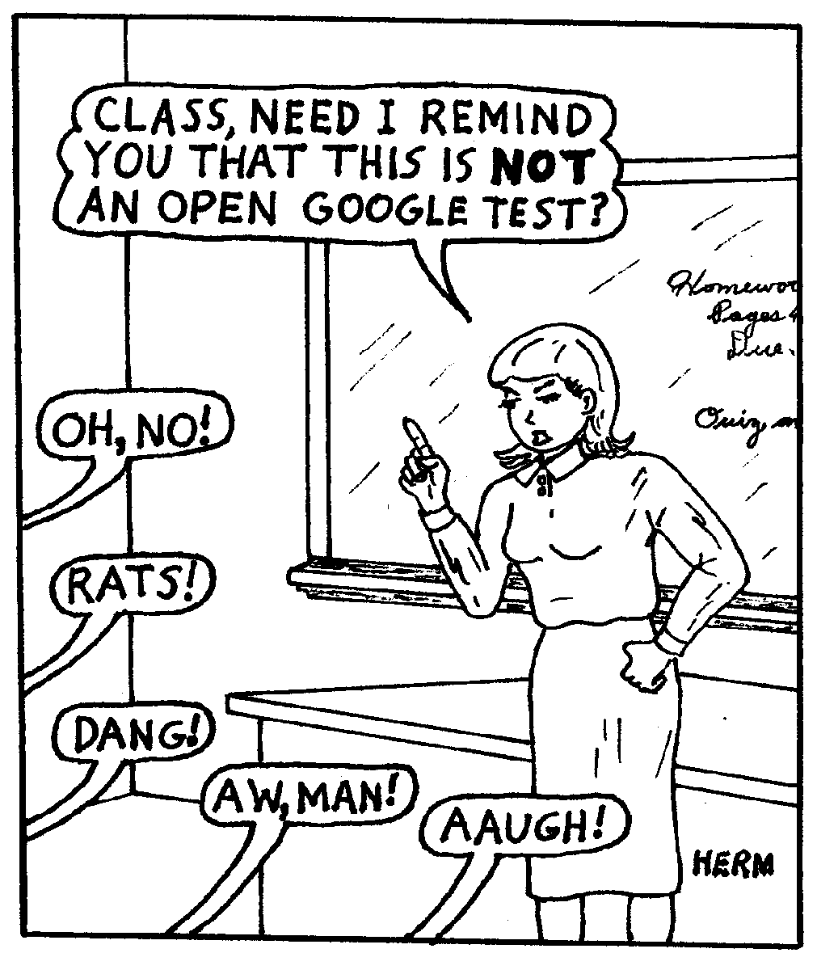

Slide 187
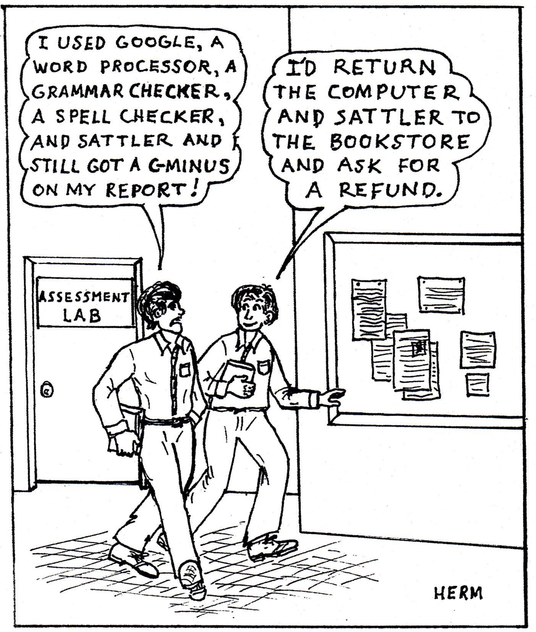

Slide 188
Reflections on Development
The Little Boy and the Old Man Said the little boy, "Sometimes I drop my spoon." Said the old man, "I do that too." The little boy whispered, "I wet my pants." I do that too," laughed the little old man. Said the little boy, "I often cry." The old man nodded, "So do I." But worst of all," said the boy, "it seems Grown-ups don't pay attention to me." And he felt the warmth of a wrinkled old hand. I know what you mean," said the little old man.”
― Shel Silverstein

